Slide 1
FACIAL RECOGNITION ATTENDANCE
GUIDED BY:
Lt.Dr.D.Antony Arul Raj M.Sc.,(CS).,MPhil.,PGDCE.,PhD.,
Associate Professor
Department of Software Systems
DONE BY
Uvan Sankar K
17MSS059
Department of Software Systems

Slide 2
ABSTRACT
There are lots of problems faced with the current technique used in the attendance system all over the world. It is a time-consuming process and there are more chances for a possible mishap during the manual attendance taking system.
All the disadvantages of the manual method of attendance system can be totally eliminated with the help of an automated facial recognition attendance system.
Facial Recognition Attendance is an attendance system that can be used to take attendance anywhere. This Facial Recognition Attendance uses technologies like Python, LBPH, and OpenCV. The system detects the face in the camera and then check it with the data saved about the particular person in the database, compares and marks attendance.

Slide 3
EXISTING SYSTEM
At present attendance marking involves manual attendance on paper sheet by professors and teachers.
The problem with this approach in which manually taking and maintains the attendance records is that it is very inconvenient and time consuming event.
Moreover, it is very difficult to verify one by one student in a large classroom environment and manual computation can also produce error after all, we all are Humans.
Also, this method is dead easy for someone to impersonate for proxy attendance and the sheet could be stolen or lost leading to many problems.

Slide 4
PROPOSED SYSTEM
The Face Recognition Attendance technique eliminates classical student attendance marking technique problems such as calling student names, proxy, and checking respective.
Face recognition student attendance system is proposed in order to replace the manual signing of the presence of students which are burdensome and causes students get distracted in order to sign for their attendance.

Slide 5
ADVANTAGES OF PROPOSED SYSTEM
Removes the risk of manual errors
Fast, Hygiene, and Secure
Proxy Attendance eliminated
Easy to maintain the records
Best for Virtual Classrooms

Slide 6
ALGORITHMS USED
Face Detection Algorithm - Haar Cascades
Face Recognition Algorithm - Local Binary Patterns Histogram

Slide 7
FACE DETECTION - WORKING OF HAAR CASCADES ALGORITHM
Haar Cascade classifier is an effective object detection approach which was proposed by Paul Viola and Michael Jones in their paper, “Rapid Object Detection using a Boosted Cascade of Simple Features” in 2001.
It is a machine learning based approach in which a cascade function is trained from a lot of positive and negative images. It is then used to detect objects in other images.
The algorithm has four stages:
Haar Feature Selection
Creating Integral Images
Adaboost training
Cascading Classifiers

Slide 8
FACE DETECTION - WORKING OF HAAR CASCADES ALGORITHM
The first stage is the Haar Feature Selection stage where the algorithm takes in features from the images. Here the Haar features extracted will be of face that we give. It uses integral images in stage to fast up the process by adding up closer pixels.
And once stage 2 is complete we will have lots of features exceeding 6000+ for a basic image which also includes some regions without faces.
In stage 3, for faster computation and saving the storage, we use Adaboost training which again is a machine learning algorithm that reduces the features from 6000+ to only the useful ones.
Now with the three steps done, the cascade classifier is trained to find the face in the image during stage 4.

Slide 9
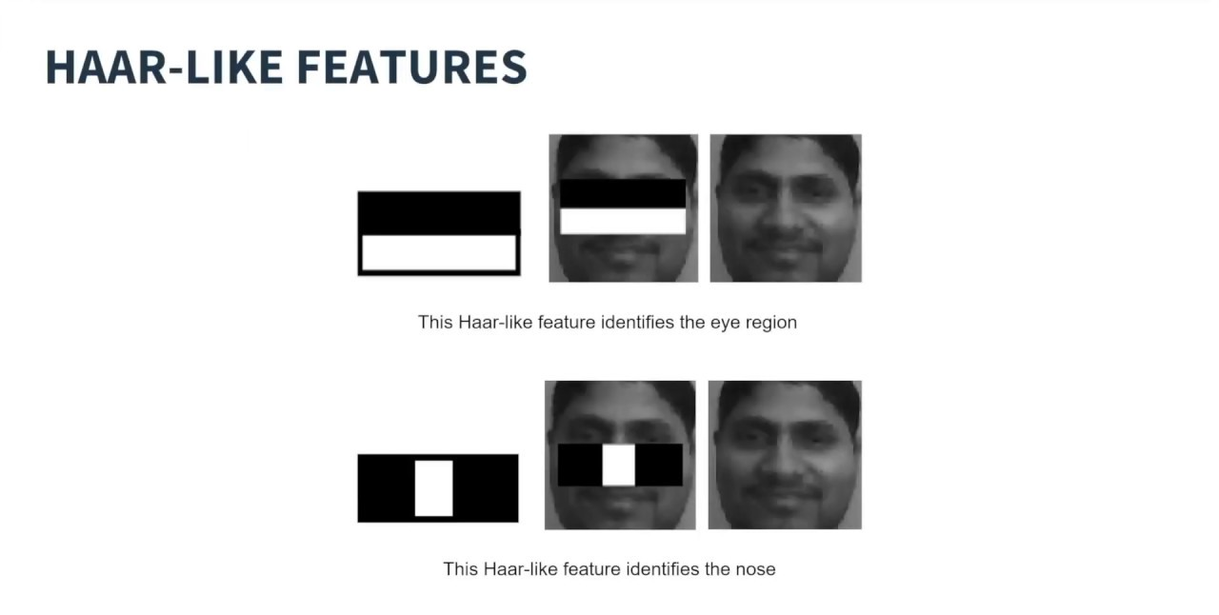
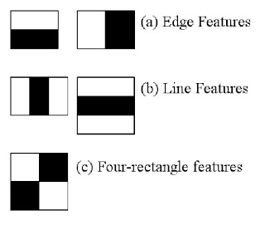
FACE DETECTION - WORKING OF HAAR CASCADES ALGORITHM

Slide 10
FACE RECOGNITION - WORKING OF LBPH ALGORITHM
Local Binary Patterns Histogram (LBPH) is a simple yet very efficient texture operator which labels the pixels of an image by thresholding the neighborhood of each pixel and considers the result as a binary number.
LBPH Algorithm works in 5 steps:
1. Parameters
2. Training the Algorithm
3. Applying the LBPH Operation
4. Extracting the Histogram
5. Performing the Face Recognition

Slide 11
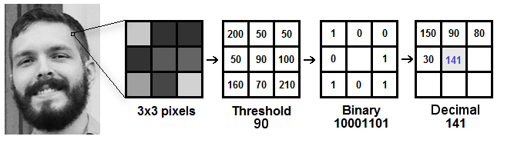
FACE RECOGNITION - WORKING OF LBPH ALGORITHM
Takes 3 x 3 Pixels sliding window
If Neighbour Pixel Value > Threshold, then 1
If Neighbour Pixel Value < Threshold, then 0
Convert Binary to Decimal
The 141 Decimal value by itself is a pixel value of the original image.

Slide 12
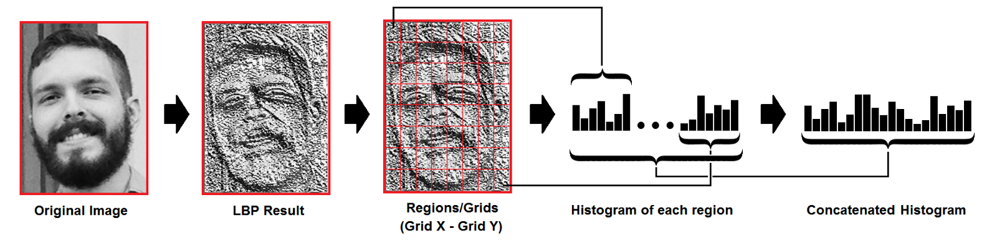
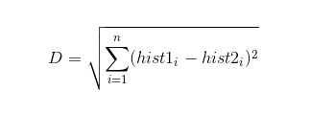
FACE RECOGNITION - WORKING OF LBPH ALGORITHM
Then, we convert it to histogram and concatenate each histogram to create a new and bigger histogram.
The final histogram represents the characteristics of the original image.
When performing face recognition, the final histogram is extracted from the input image and is then compared with the existing ones by calculating the distance between two histograms using Euclidean distance.
The face that matches the input image with the closest histogram is returned as the found face.

Slide 13
HARDWARE SPECIFICATIONS
S.NO | CONTENTS | REQUIREMENTS
1. | PROCESSOR | Intel i3 or i5
2. | RAM | 4GB or Higher
3. | GPU | Nvidia GeForce GTX 800/900 Series or Nvidia GeForce MX Series or Intel HD Integrated Graphics
4. | HARD DISK CAPACITY | 300GB or Above
5. | CAMERA | 720p HD Webcam

Slide 14
SOFTWARE SPECIFICATIONS
S.NO | CONTENTS | REQUIREMENTS
1. | OPERATING SYSTEM | Ubuntu 18.04 LTS or Windows 10 2004
2. | FRONT-END | PyCharm 2020.2.1 and Python 3.6
3. | BACK –END | OpenCV and Microsoft Excel
4. | OpenCV | VERSION 4.1.0 or Higher

Slide 15
MODULES
Check Camera:
To check if camera is connected to the system and if it is working.
Capture Faces:
Detect the faces in the camera feed using Haar Cascades Algorithm and capture the images for the dataset.
Train Images:
Train the model by using the captured images in Capture Faces module as the dataset.
Recognize and Mark Attendance:
The final module uses Haar Cascades to detect the images, then uses LBPH algorithm to recognize the student in the camera feed and then marks the attendance for the student.

Slide 16
SYSTEM FLOW DIAGRAM

Slide 17
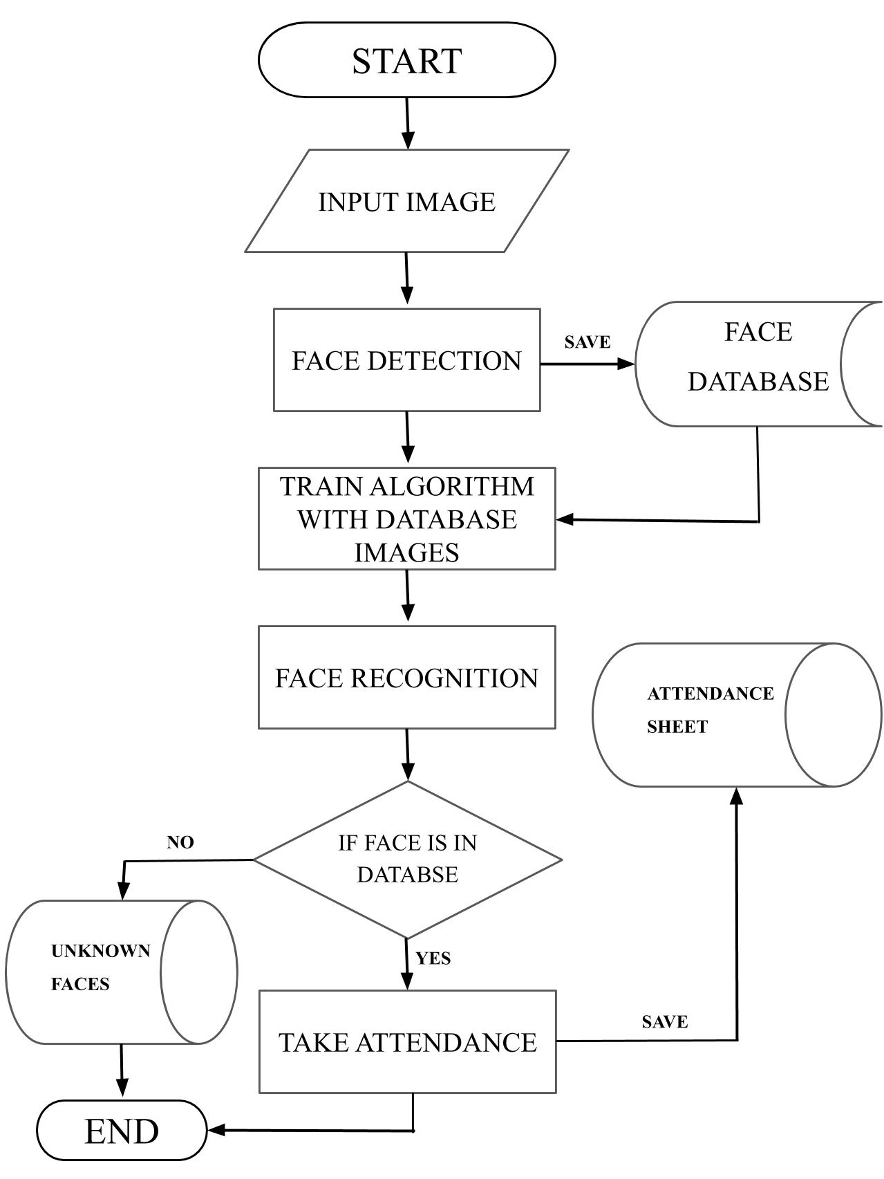

Slide 18
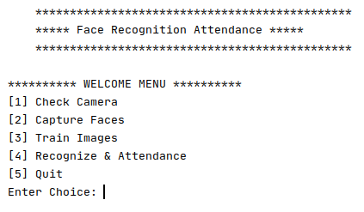
FRONT END DESIGN

Slide 19
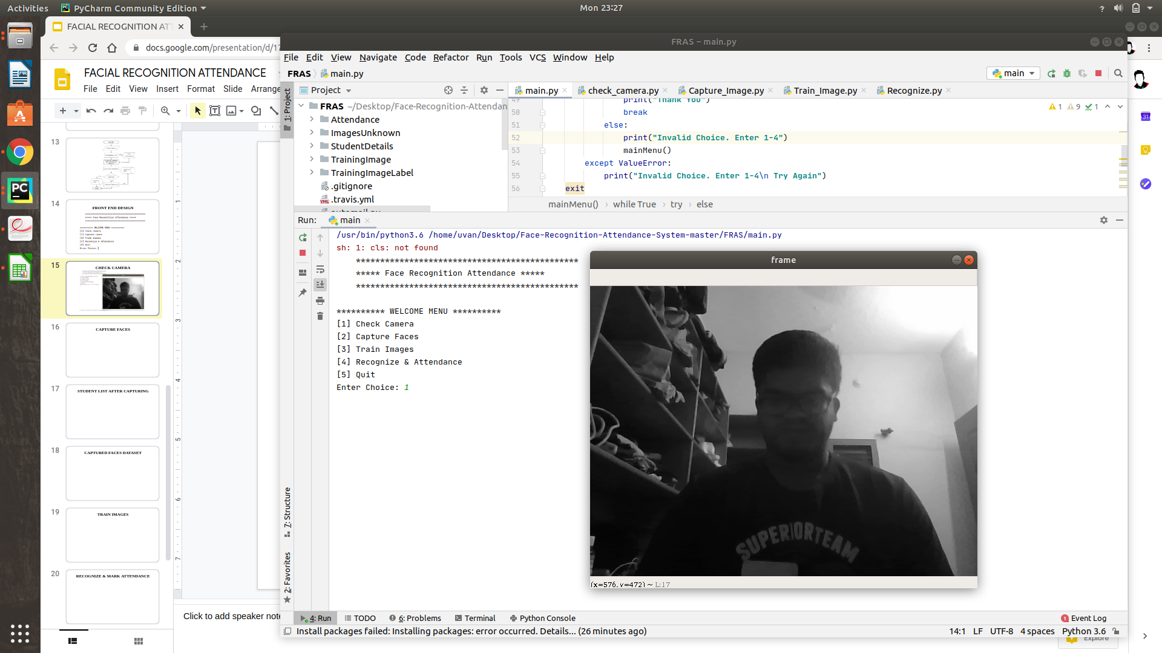
CHECK CAMERA

Slide 20
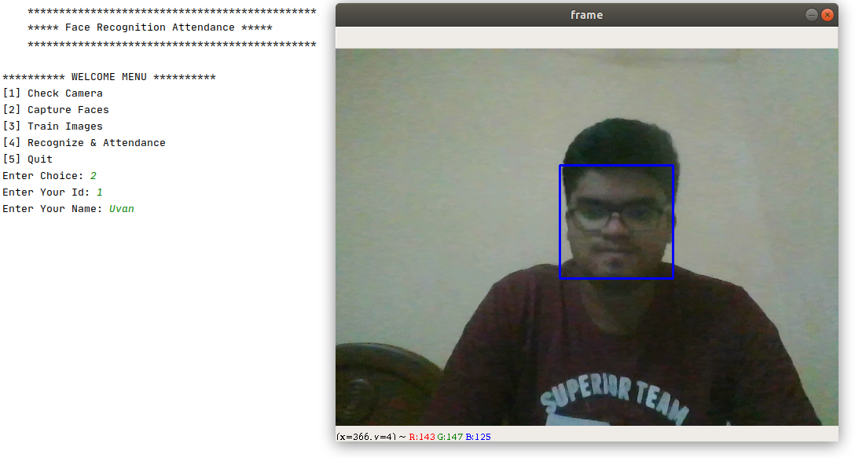
CAPTURE FACES

Slide 21
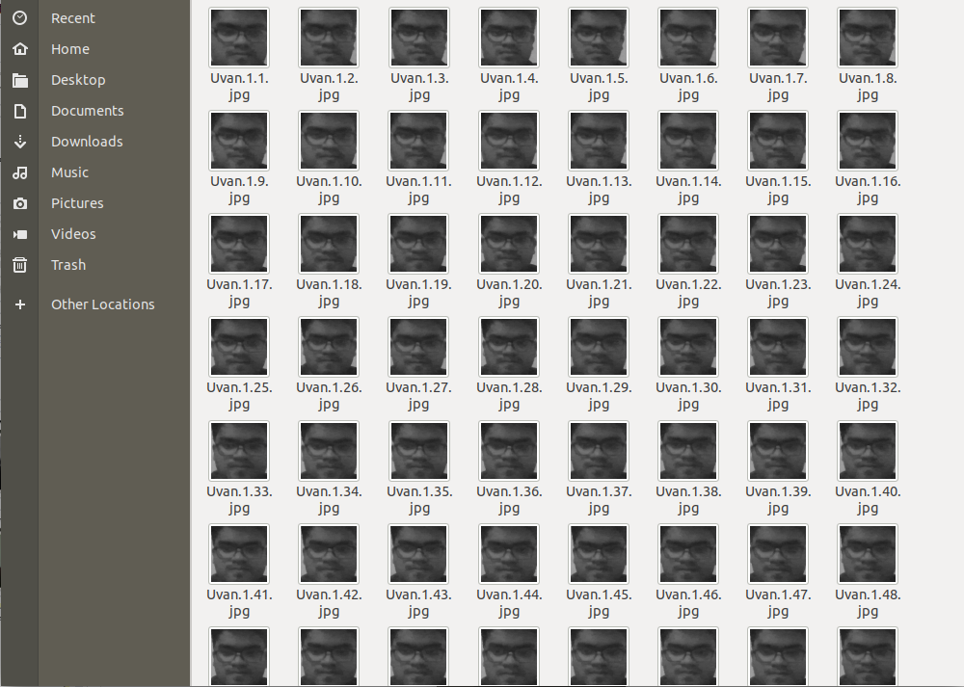
FACE DATABASE

Slide 22
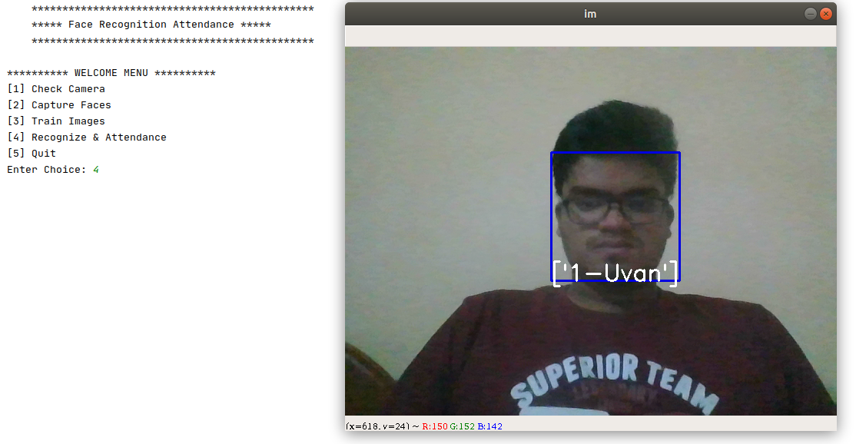
RECOGNIZE & MARK ATTENDANCE

Slide 23

ATTENDANCE SHEET REPORT

Slide 24
FUTURE SCOPE
Can be implemented using Raspberry Pi in University, Schools, and Offices.
Use of Deep Learning and Neural Networks to detect faces as it will give great accuracy than Haar Cascade Algorithm.
But it requires lot of computing power and data to train along with a powerful device to run like Nvidia Jetson Nano.
Nvidia provides custom Deep Learning libraries like Transfer Learning Toolkit to train and deploy in Jetson Nano.
The training and deployment process in Nvidia’s TLT is very complex and time consuming.

Slide 25
THANK YOU!

